Slide 1
Cairo TMC
Cairo Traffic Management Controller

Slide 2
Agenda
Introduction
Database Model (ERD Diagram)
SQL Server 2008 Spatial Data
Project Algorithms

Slide 3
Introduction
Cairo map has been downloaded from http://www.openstreetmap.org/
OpenStreetMap provides map in “.osm” XML files
Using the spatial features of MS SQL Server 2008 R2 the XML file has been loaded into a database.
The Map data remodeled as Graphs considering locations as vertices and streets as edges.
Some algorithms has been applied on these graphs to provide some required services to the application end-user such as shortest path between 2 nodes and nearest K streets from his location.

Slide 4
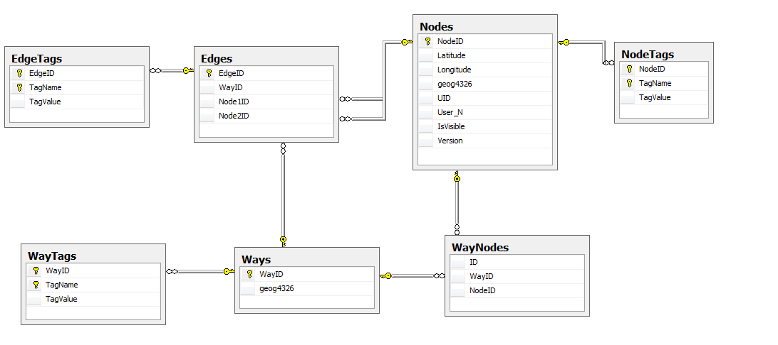
Database Model(ERD Diagram)

Slide 5
Table: Ways
Column | Data Type | Description
WayID | Int | Identifier to map ways.
Geog | Geography | The geography spatial data type, geography, is implemented as a .NET common language runtime (CLR) data type in SQL Server. This type represents data in a round-earth coordinate system. The SQL Server geography data type stores ellipsoidal (round-earth) data, such as GPS latitude and longitude coordinates.

Slide 6
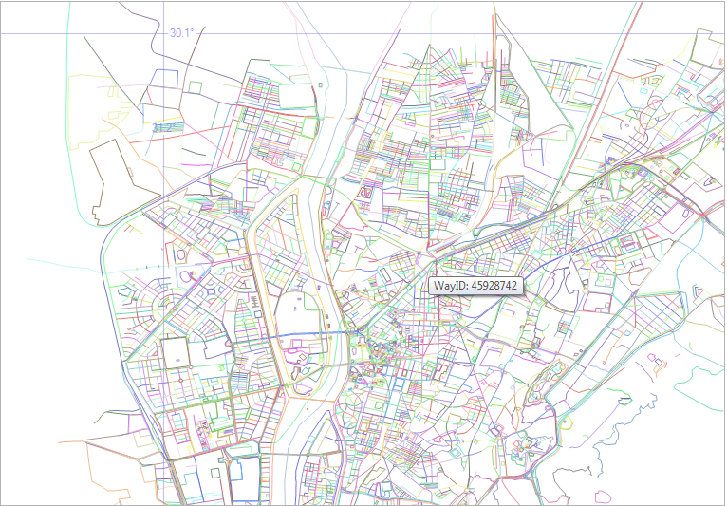
Table: Ways (Output)

Slide 7
Table: Way Tags
Column | Data Type | Description
WayID | Int | Identifier to map ways.
Tag Name | varchar | Used to tag a way, each way may have multiple tag. List of famous tags: Name:en → English name of a way Name:ar → Arabic Name of a way Bridge → is it a bridge? Highway → is it a highway? Waterway → is it a water way? Oneway → is it a one way?
Tag Value | varchar | Value for a Tag

Slide 8
Table: Nodes + Tags
Column | Data Type | Description
Node ID | decimal | Node Identifier
Longitude | varchar | Used to tag a way, each way may have
Latitude | varchar | Value for a Tag
geog | Geography | Geography spatial representation od a node

Slide 9
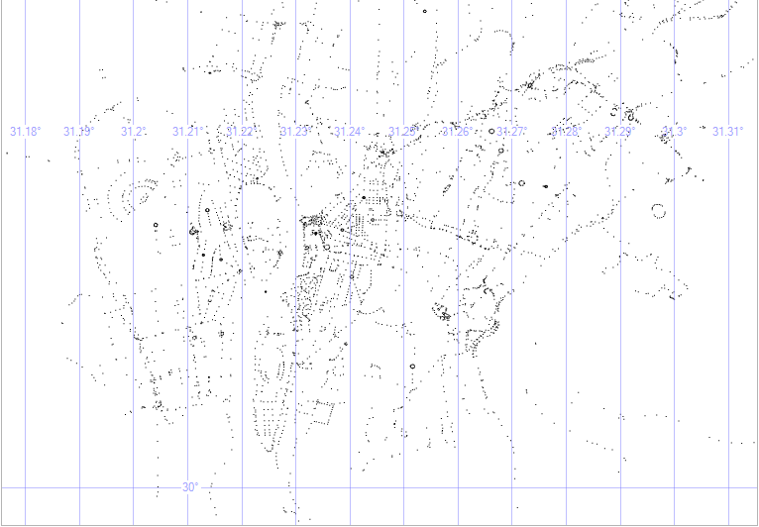
Table: Nodes (Output)

Slide 10
Table: Way Nodes
Column | Data Type | Description
Way ID | Int | Way Identifier
Node ID | decimal | Node Identifier

Slide 11
Table: Edges + Tags
Column | Data Type | Description
Edge ID | Int | Node Identifier
Way ID | Int | Way Identifier
Node1 ID | Decimal | Node1 Identifier
Node2 ID | Decimal | Node2 Identifier

Slide 12
SQL 2008 Spatial Data*
SQL Server 2008 supports the geometry and geography data types
These types support methods and properties that allow for the creation, comparison, analysis, and retrieval of spatial data.
The geometry data type supports planar, or Euclidean (flat-earth), data
The geometry data type conforms to the Open Geospatial Consortium (OGC) Simple Features for SQL Specification version 1.1.0.
In addition, SQL Server supports the geography data type, which stores ellipsoidal (round-earth) data, such as GPS latitude and longitude coordinates.
* MSDN

Slide 13
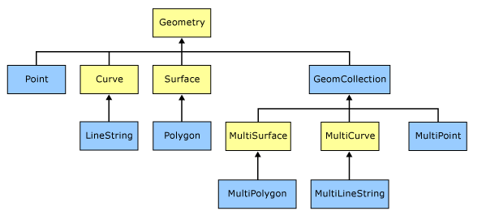
Geometry Type hierarchy
The figure depicts the geometry hierarchy upon which the geometry and geography data types are based.
The instantiable types of geometry and geography are indicated in blue.

Slide 14
geography Data Type references
http://msdn.microsoft.com/en-us/library/bb933876(v=sql.105).aspx
http://msdn.microsoft.com/en-us/library/bb933790(v=sql.105).aspx
http://msdn.microsoft.com/en-us/library/bb964711(v=sql.105).aspx
http://www.opengeospatial.org/standards/sfa

Slide 15
Project Algorithms
Breadth First Search
Dijkstra Shortest path
Weighting and capacity Calculating & Analysis
K-Nearest roads with Static Region
K-Nearest roads with Dynamic Region
K- Nearest Nodes (Nearest Hospital, Media, Building, …etc)

Slide 16
K-Nearest roads with Static Region
--Implementing K-Nearest neighbors: Enlarging regional algorithm
DECLARE @X GEOGRAPHY
DECLARE @WayID INT
-- Must be system parameters
SET @WayID = 5091214
SELECT @X = geog4326 FROM Ways WHERE WayID = @WayID
-- The entire table must be scanned, and the distance of each to the search point must be calculated
--We could conceivably improve on this by restricting our search space to to the immediate region around the target point:
DECLARE @start FLOAT = 1000; -- 1 KM
WITH NearestPoints AS
(
SELECT TOP(1) WITH TIES *, Ways.geog4326.STDistance(@x) AS dist -- WITH TIES make sure every object in the region will be in the result set
FROM numbers JOIN Ways WITH(INDEX(spatial_index))
ON Ways.geog4326.STDistance(@x) < @start*POWER(2,Numbers.n)
ORDER BY n
)
SELECT TOP(10) FROM NearestPoints ORDER BY n, dist

Slide 17
K-Nearest roads with Dynamic Region
--Implementing K-Nearest neighbors: Fixed region algorithm.
DECLARE @X GEOGRAPHY
DECLARE @WayID INT
-- Must be system parameters
SET @WayID = 5091214
SELECT @X = geog4326 FROM Ways WHERE WayID = @WayID
-- The entire table must be scanned, and the distance of each to the search point must be calculated
--We could conceivably improve on this by restricting our search space to to the immediate region around the target point:
DECLARE @region geography = @x.STBuffer(10000)
SELECT TOP(10) Ways.* , WayTags.TagName, WayTags.TagValue
FROM Ways
LEFT JOIN WayTags
ON Ways.WayID = WayTags.WayID
AND TagName = 'name:en'
WHERE geog4326.Filter(@region) = 1
ORDER BY geog4326.STDistance(@X) ASC

Slide 18
K- Nearest Nodes (Nearest Hospital, Media, Building, …etc)
insert into @Node select n.NodeID,NodeTags.TagValue,n.Longitude,n.Latitude,geog4326
from NodeTags nt inner join Nodes n on n.NodeID=nt.NodeID
and (@TagName IS NULL or @TagName = nt.TagName )
and (@TagValue IS NULL or @TagValue = nt.TagValue )
and dbo.IfNodeIsInCircle(n.NodeID,@NodeID,@Radius) = 1
left outer join NodeTags on n.NodeID = NodeTags.NodeID and NodeTags.TagName = 'name'
while (@@ROWCOUNT =0 and @Radius < @MaxRadius)
Begin
SET @Radius = @Radius + @IncreaseRadiusBy;
insert into @Node select n.NodeID,NodeTags.TagValue,n.Longitude,n.Latitude,geog4326
from NodeTags nt inner join Nodes n on n.NodeID=nt.NodeID
and (@TagName IS NULL or @TagName = nt.TagName )
and (@TagValue IS NULL or @TagValue = nt.TagValue )
and dbo.IfNodeIsInCircle(n.NodeID,@NodeID,@Radius) = 1
left outer join NodeTags on n.NodeID = NodeTags.NodeID and NodeTags.TagName = 'name'
end
Return

Slide 19
K- Nearest Nodes (Nearest Hospital, Media, Building, …etc)
CREATE FUNCTION IfNodeIsInCircle
(
@NodeID NodeID,
@CenterNodeID NodeID,
@Radius decimal(21,6)
)
-- select dbo.IfNodeIsInCircle(670117016,670117058,0.01)
RETURNS bit
AS
BEGIN
declare @Distance decimal(21,6),@bInCircle bit
select @Distance = sqrt((centerNode.Longitude - Node.Longitude)*(centerNode.Longitude - Node.Longitude) + (centerNode.Latitude - Node.Latitude)*(centerNode.Latitude - Node.Latitude))
from Nodes centerNode,Nodes Node where centerNode.NodeID=@CenterNodeID and Node.NodeID=@NodeID
if(@Distance <= @Radius)
SET @bInCircle = 1;
else
SET @bInCircle = 0;
Return @bInCircle;

Slide 20
Weighting and capacity
Add extra metadata for all edges.
Add API to Reset Road Weight / Increase / Decrease (Weight/Edges)
(Cloud Publication)
API to get Current Way Profile Which Include
Way Nature (Highway or not)
Average Weight
Way Capacity
Car Length
No of Lanes (Highway/Regular)
Total Length

Slide 21
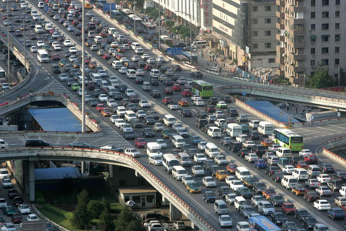
OMG

Slide 22
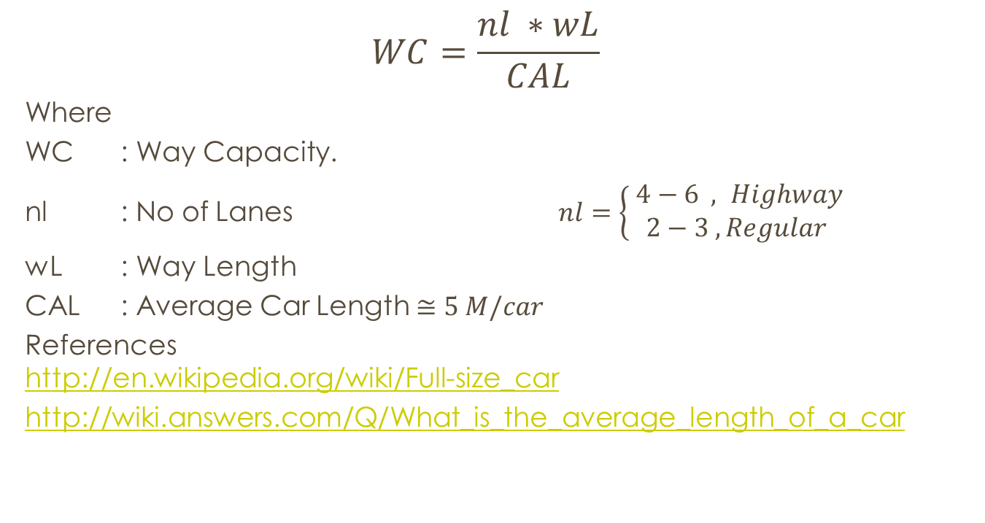
Way Capacity Calculations
$$WC=\frac{nl ∗wL}{CAL}$$
Where
WC : Way Capacity.
nl : No of Lanes $nl=\left\{\begin{aligned} 4−6 , Highway \\ 2−3 , Regular\end{aligned}\right.$
wL : Way Length
CAL : Average Car Length $≅5 M/car$
References http://en.wikipedia.org/wiki/Full-size_car
http://wiki.answers.com/Q/What_is_the_average_length_of_a_car

